Slide 1

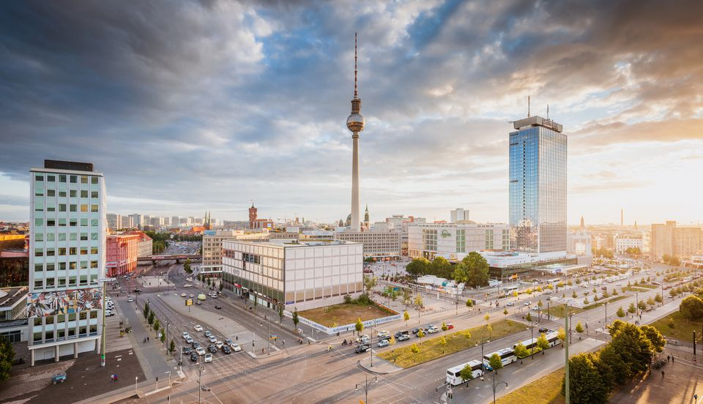
Capstone Project - The Battle of the Neighborhoods (Week 2)
Applied Data Science Capstone by IBM/Coursera

Slide 2
Table of contents¶
Introduction: Business Problem
Data
Methodology
Analysis
Results and Discussion
Conclusion

Slide 3
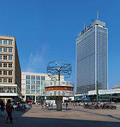
Introduction: Business Problem
In this project we will try to find an optimal location for a restaurant. Specifically, this report will be targeted to stakeholders interested in opening an Italian restaurant in Berlin, Germany.
Since there are lots of restaurants in Berlin we will try to detect locations that are not already crowded with restaurants. We are also particularly interested in areas with no Italian restaurants in vicinity. We would also prefer locations as close to city center as possible, assuming that first two conditions are met.
We will use our data science powers to generate a few most promissing neighborhoods based on this criteria. Advantages of each area will then be clearly expressed so that best possible final location can be chosen by stakeholders.

Slide 4
Data
Based on definition of our problem, factors that will influence our decission are:
1
number of existing restaurants in the neighborhood (any type of restaurant)
2
number of and distance to Italian restaurants in the neighborhood, if any
3
distance of neighborhood from city center
4
We decided to use regularly spaced grid of locations, centered around city center, to define our neighborhoods.
5
Following data sources will be needed to extract/generate the required information:
6
centers of candidate areas will be generated algorithmically and approximate addresses of centers of those areas will be obtained using Google Maps API reverse geocoding
7
number of restaurants and their type and location in every neighborhood will be obtained using Foursquare API
8
coordinate of Berlin center will be obtained using Google Maps API geocoding of well known Berlin location (Alexanderplatz)
9

Slide 5
Neighborhood Candidates¶
Let's create latitude & longitude coordinates for centroids of our candidate neighborhoods. We will create a grid of cells covering our area of interest which is aprox. 12x12 killometers centered around Berlin city center.
Let's first find the latitude & longitude of Berlin city center, using specific, well known address and Google Maps geocoding AP
Coordinate of Alexanderplatz, Berlin, Germany:
[52.5219184, 13.4132147]

Slide 6
Methodology
In this project we will direct our efforts on detecting areas of Berlin that have low restaurant density, particularly those with low number of Italian restaurants. We will limit our analysis to area ~6km around city center.
In first step we have collected the required data: location and type (category) of every restaurant within 6km from Berlin center (Alexanderplatz). We have also identified Italian restaurants (according to Foursquare categorization).
Second step in our analysis will be calculation and exploration of 'restaurant density' across different areas of Berlin - we will use heatmaps to identify a few promising areas close to center with low number of restaurants in general (and no Italian restaurants in vicinity) and focus our attention on those areas.
In third and final step we will focus on most promising areas and within those create clusters of locations that meet some basic requirements established in discussion with stakeholders: we will take into consideration locations with no more than two restaurants in radius of 250 meters, and we want locations without Italian restaurants in radius of 400 meters. We will present map of all such locations but also create clusters (using k-means clustering) of those locations to identify general zones / neighborhoods / addresses which should be a starting point for final 'street level' exploration and search for optimal venue location by stakeholders.

Slide 7
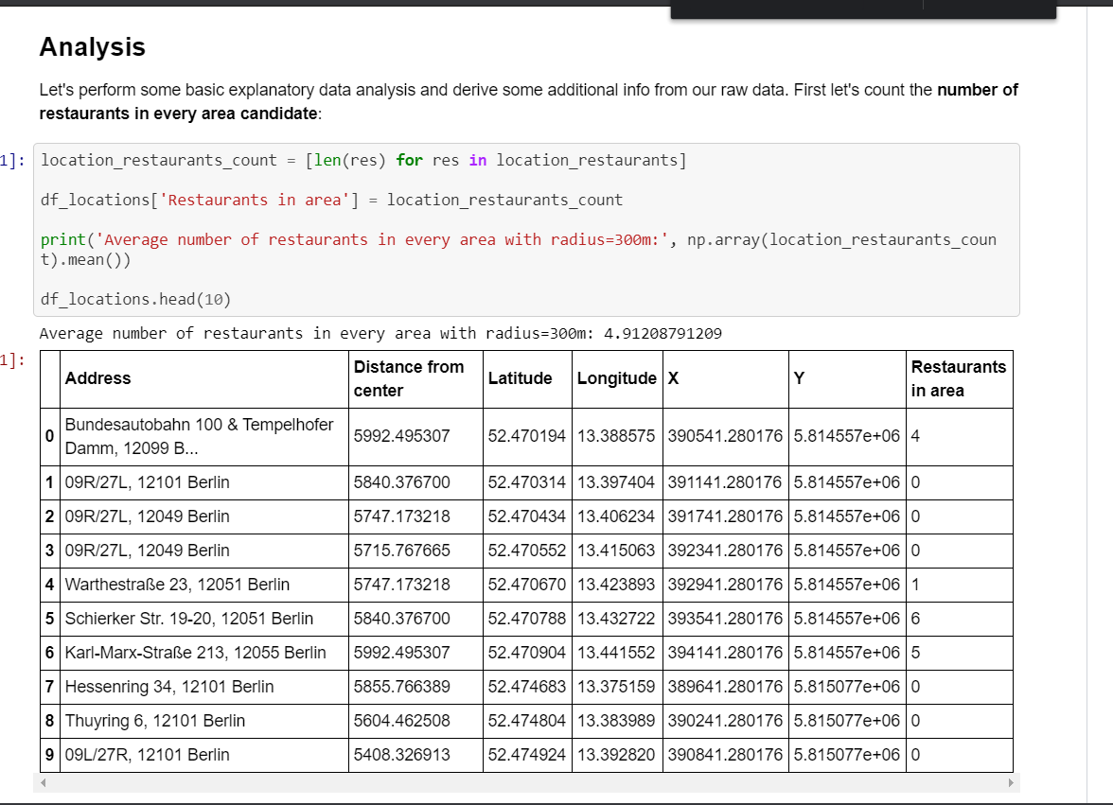
Analysis
Let's perform some basic explanatory data analysis and derive some additional info from our raw data. First let's count the number of restaurants in every area candidate:

Slide 8
Results and Discussion ¶
Our analysis shows that although there is a great number of restaurants in Berlin (~2000 in our initial area of interest which was 12x12km around Alexanderplatz), there are pockets of low restaurant density fairly close to city center. Highest concentration of restaurants was detected north and west from Alexanderplatz, so we focused our attention to areas south, south-east and east, corresponding to boroughs Kreuzberg, Friedrichshain and south-east corner of central Mitte borough. Another borough was identified as potentially interesting (Prenzlauer Berg, north-east from Alexanderplatz), but our attention was focused on Kreuzberg and Friedrichshain which offer a combination of popularity among tourists, closeness to city center, strong socio-economic dynamics and a number of pockets of low restaurant density.
After directing our attention to this more narrow area of interest (covering approx. 5x5km south-east from Alexanderplatz) we first created a dense grid of location candidates (spaced 100m appart); those locations were then filtered so that those with more than two restaurants in radius of 250m and those with an Italian restaurant closer than 400m were removed.
Those location candidates were then clustered to create zones of interest which contain greatest number of location candidates. Addresses of centers of those zones were also generated using reverse geocoding to be used as markers/starting points for more detailed local analysis based on other factors.
Result of all this is 15 zones containing largest number of potential new restaurant locations based on number of and distance to existing venues - both restaurants in general and Italian restaurants particularly. This, of course, does not imply that those zones are actually optimal locations for a new restaurant! Purpose of this analysis was to only provide info on areas close to Berlin center but not crowded with existing restaurants (particularly Italian) - it is entirely possible that there is a very good reason for small number of restaurants in any of those areas, reasons which would make them unsuitable for a new restaurant regardless of lack of competition in the area. Recommended zones should therefore be considered only as a starting point for more detailed analysis which could eventually result in location which has not only no nearby competition but also other factors taken into account and all other relevant conditions met.

Slide 9
Conclusion
Purpose of this project was to identify Berlin areas close to center with low number of restaurants (particularly Italian restaurants) in order to aid stakeholders in narrowing down the search for optimal location for a new Italian restaurant. By calculating restaurant density distribution from Foursquare data we have first identified general boroughs that justify further analysis (Kreuzberg and Friedrichshain), and then generated extensive collection of locations which satisfy some basic requirements regarding existing nearby restaurants. Clustering of those locations was then performed in order to create major zones of interest (containing greatest number of potential locations) and addresses of those zone centers were created to be used as starting points for final exploration by stakeholders.
Final decission on optimal restaurant location will be made by stakeholders based on specific characteristics of neighborhoods and locations in every recommended zone, taking into consideration additional factors like attractiveness of each location (proximity to park or water), levels of noise / proximity to major roads, real estate availability, prices, social and economic dynamics of every neighborhood etc.

